Slide 1
RESUME MATCH CHECKER
An AI-assisted resume & ATS checker — designed, built, and deployed end-to-end
ATS Scoring
Semantic Job Matching
Free AI Analysis
github.com/Aditib2000/resume-match-checker
Aaditi Dharmendra Bhandari

Slide 2
THE PROBLEM
Most resumes never reach a recruiters
Applicant Tracking Systems screen resumes before a recruiter ever opens them often on formatting quirks and keyword overlap alone, with no feedback on what went wrong.
📄
🔍
⏱️
Formatting trips up parsers
Keyword & skill mismatches
Zero feedback on rejection
Inconsistent bullets, missing headers, or unusual characters silently break ATS text extraction.
Real experience gets filtered out simply because it's phrased differently than the job posting.
Candidates rarely learn why a resume was screened out or how to actually fix it.
02 / 10

Slide 3
THE SOLUTION
Three checks in one free tool
🛡️
🎯
💡
ATS Compatibility
Smart Job Matching
AI Gap Analysis
Rule-based checks for contact info, section headers, bullet & date consistency, and parse-breaking characters.
A local embedding model compares resume bullets to job requirements by meaning — not just exact keywords.
Claude explains weak matches and suggests rewrites completely optional, and free when run locally.
03 / 10

Slide 4
HOW IT WORKS
Under the hood
📄
⚙️
🧮
📊
📄
▶
▶
▶
▶
Resume + Job Post
Parse & Extract
ATS Rules +
Embedding Match
Score & Report
PDF / Web UI
txt / pdf / docx
src/parse.py
local, free
gauges + tables
fpdf2 + Streamlit
100% local processing for scoring — no data ever leaves your machine unless you opt into Claude gap analysis.
04 / 10

Slide 5
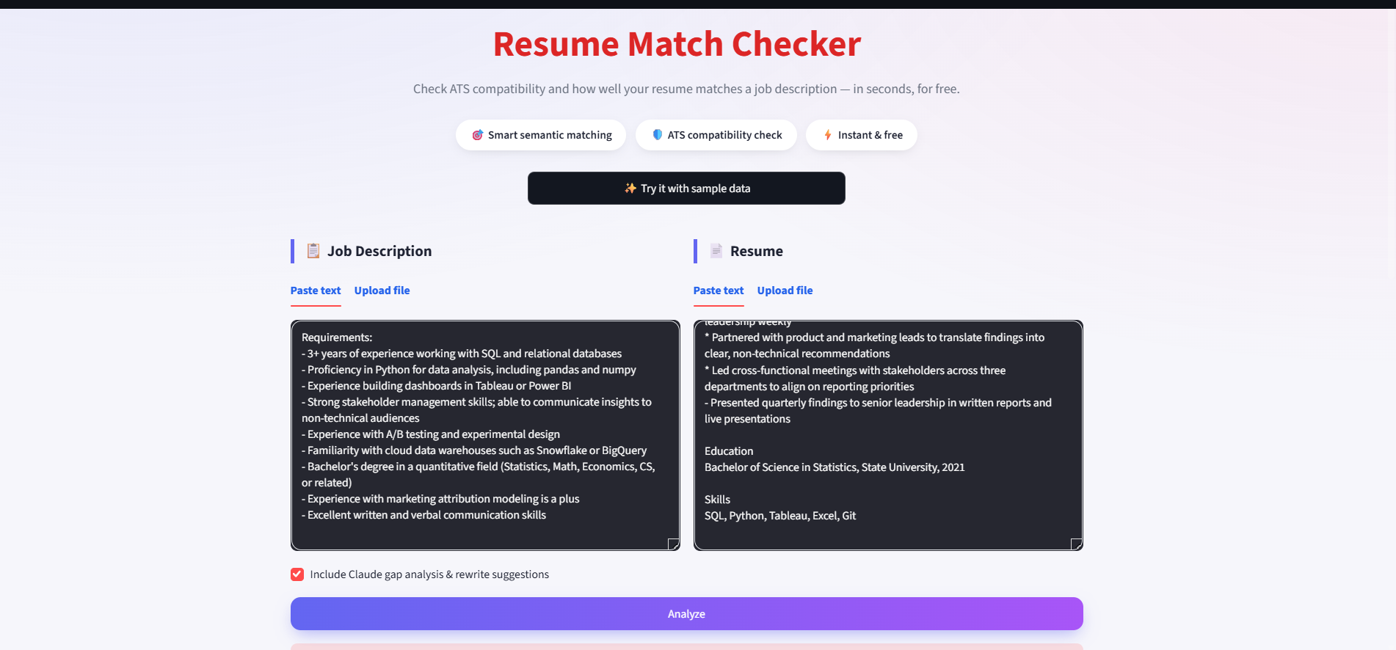
THE WEBSITE
A friendly front door
Paste or upload or try it instantly with built-in sample data.
05 / 10

Slide 6
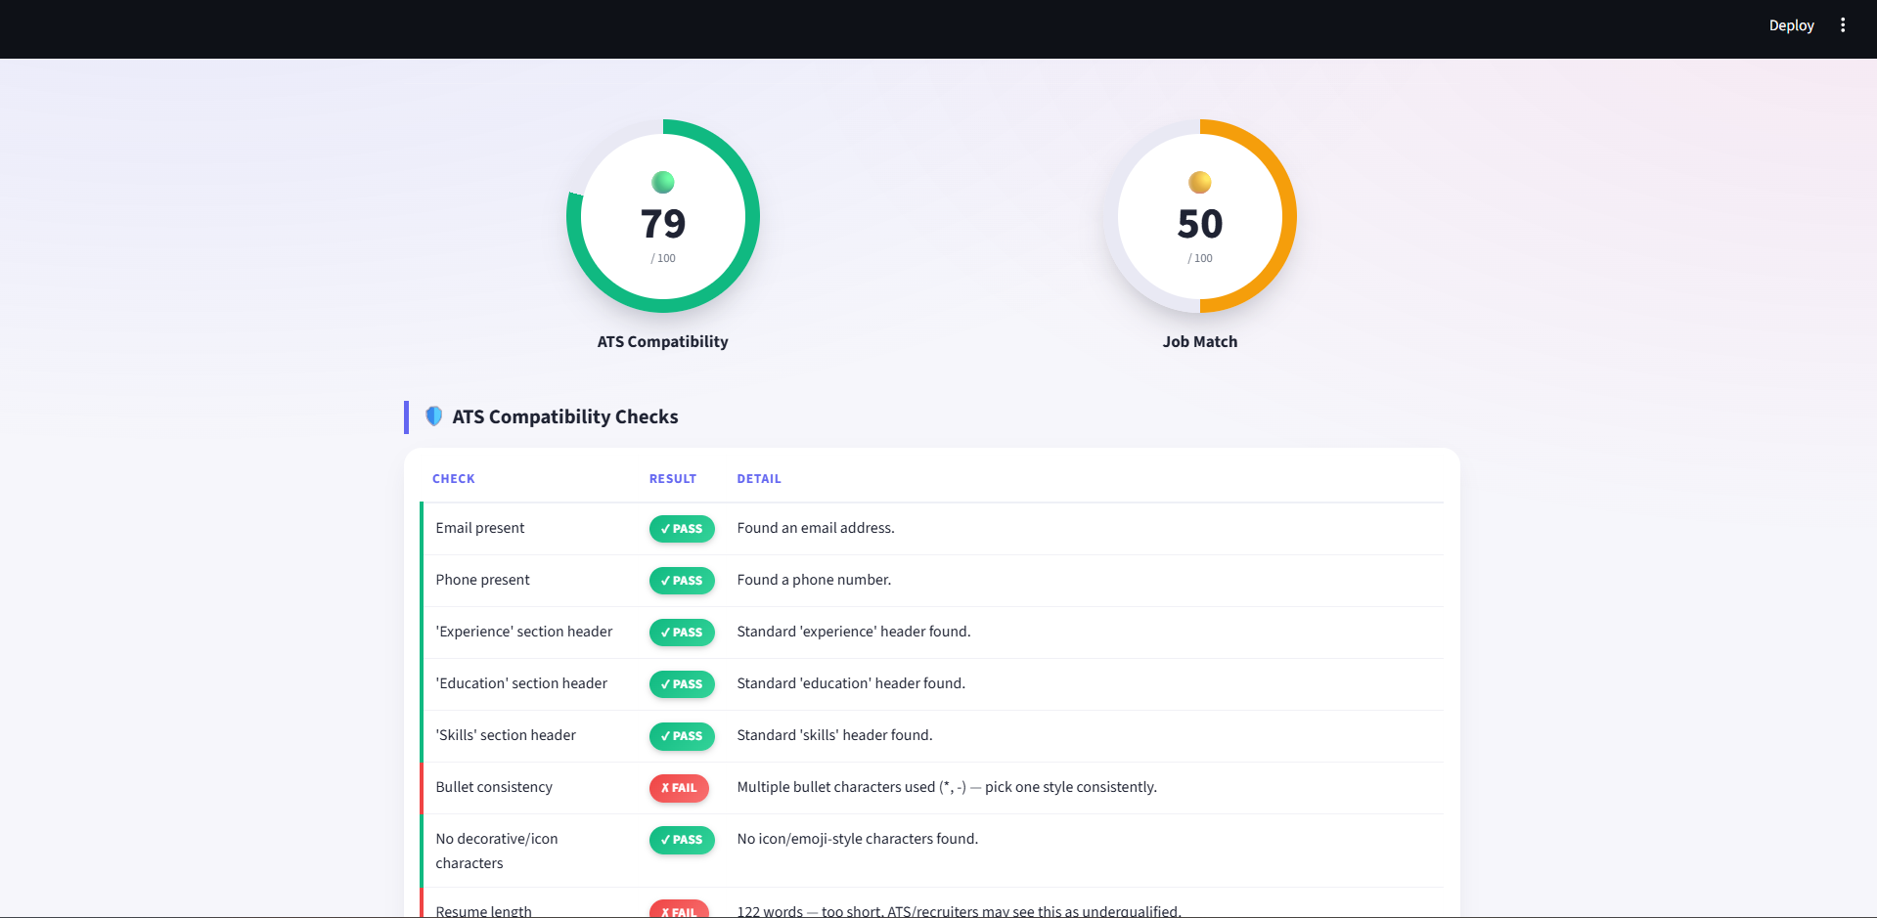
Results that actually help
Circular score gauges, color-coded requirement matches, and a downloadable PDF report.
06 / 10

Slide 7
Live ATS feedback while you edit
A PostToolUse hook automatically re-runs the ATS check whenever Claude edits a resume file — instant score feedback while revising, with no extra command to type.
✏️
⚙️
📣
→
→
Claude edits
resume.txt
Hook fires
automatically
ATS score shown
instantly
“ATS check: resume.txt scored 79/100. Failed: Bullet consistency; Date formatting”
08 / 10

Slide 8
Free. Open source.
Try it Now
🌐 Try the live app — link in this post
🔗 github.com/Aditib2000/resume-match-checker
Aaditi Dharmendra Bhandari

